Slide 1
ONLINE NOTICE BOARD

Slide 2

HELLO!
M.Prasad ,
(18A95A0506).

Slide 3
AIM
To create and design a portal where the students can access the circulars and notices by simply logging in.

Slide 4
Technologies Used
MEAN STACK
MongoDb
ExpressJS
AngularJS
Node.js

Slide 5
HOME PAGE
The Home Page consists of :
Home: The user is redirected to a page which consists of sign in and sign up forms.
About: The user is redirected to the which contains description about Online Notice Board.
Contact: The user can view the contact details of Online Notice Board Admin.

Slide 6
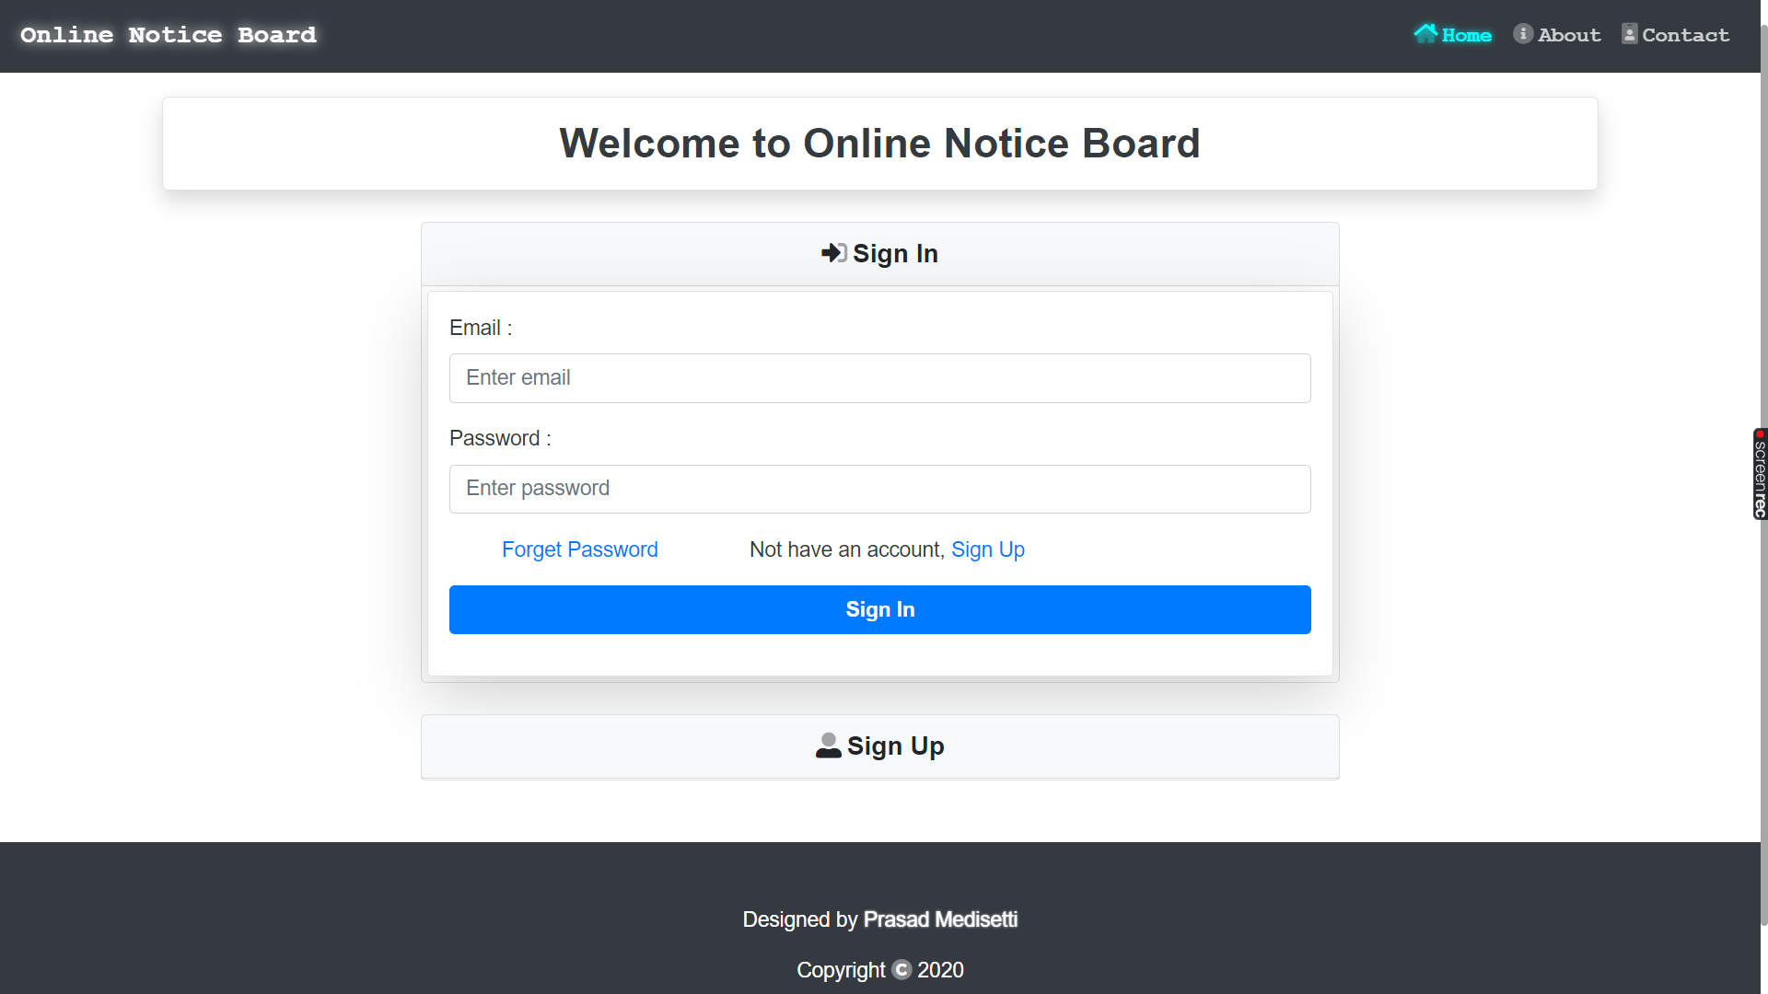

Slide 7
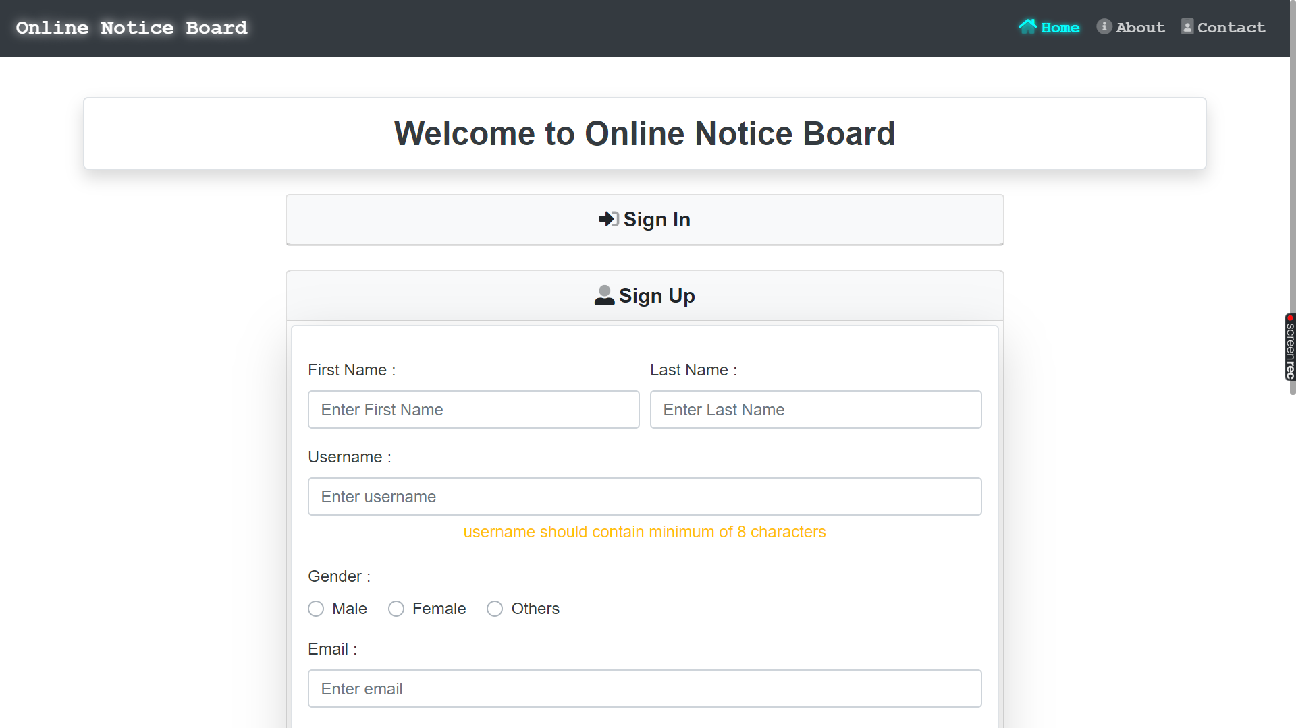

Slide 8
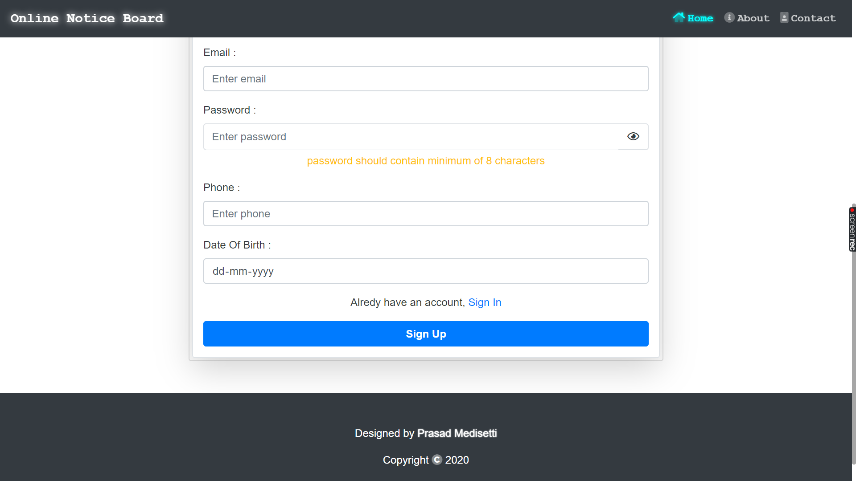

Slide 9
ABOUT PAGE
Through this page the user can understand the aim of this Online Notice Board.

Slide 10
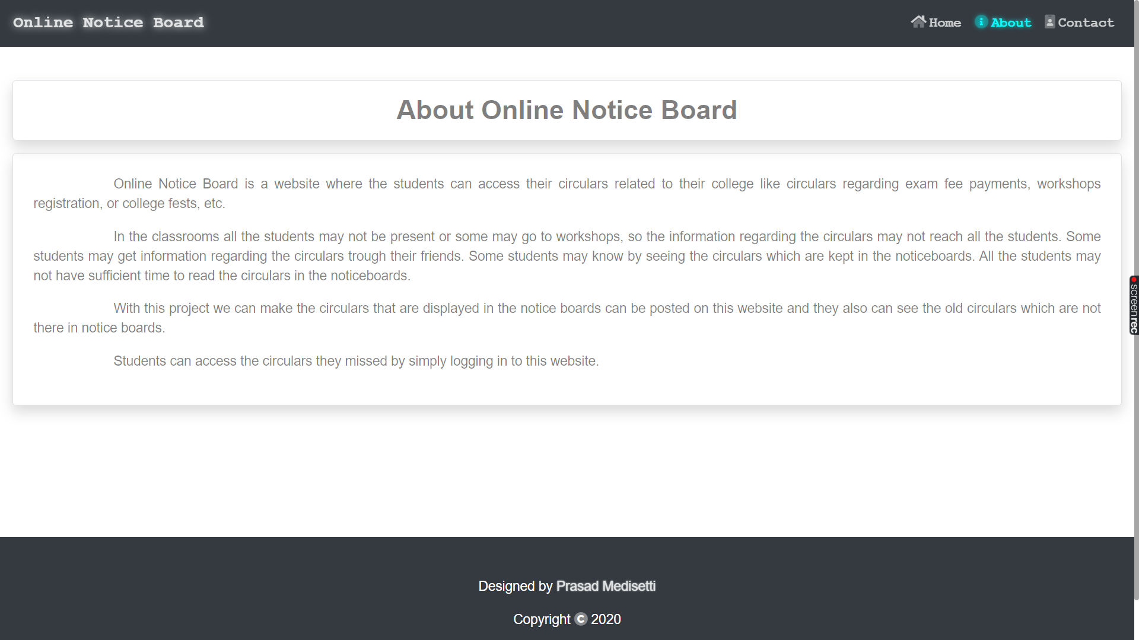

Slide 11
CONTACT PAGE
Through this page the user can contact the adminstrator of Online Notice Board.

Slide 13
ADMIN LOGIN PAGE
This is the page where the admin can login. After the successful login admin is redirected to dashboard page.

Slide 14
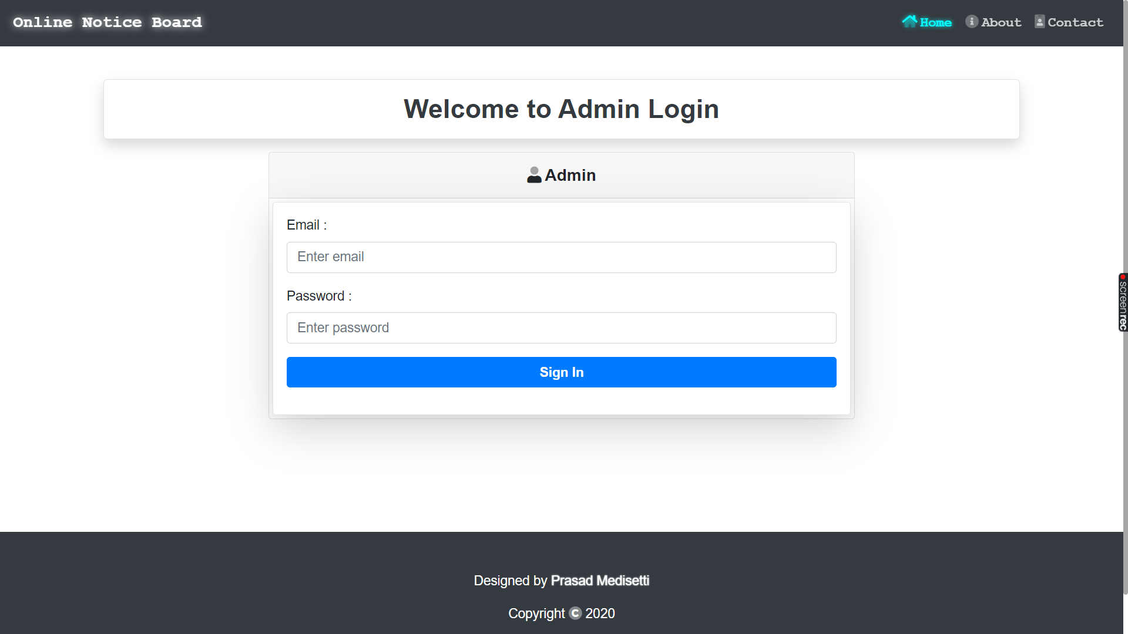

Slide 15
ADMIN DASHBOARD PAGE
This is the page where the admin can manage the posts.

Slide 16
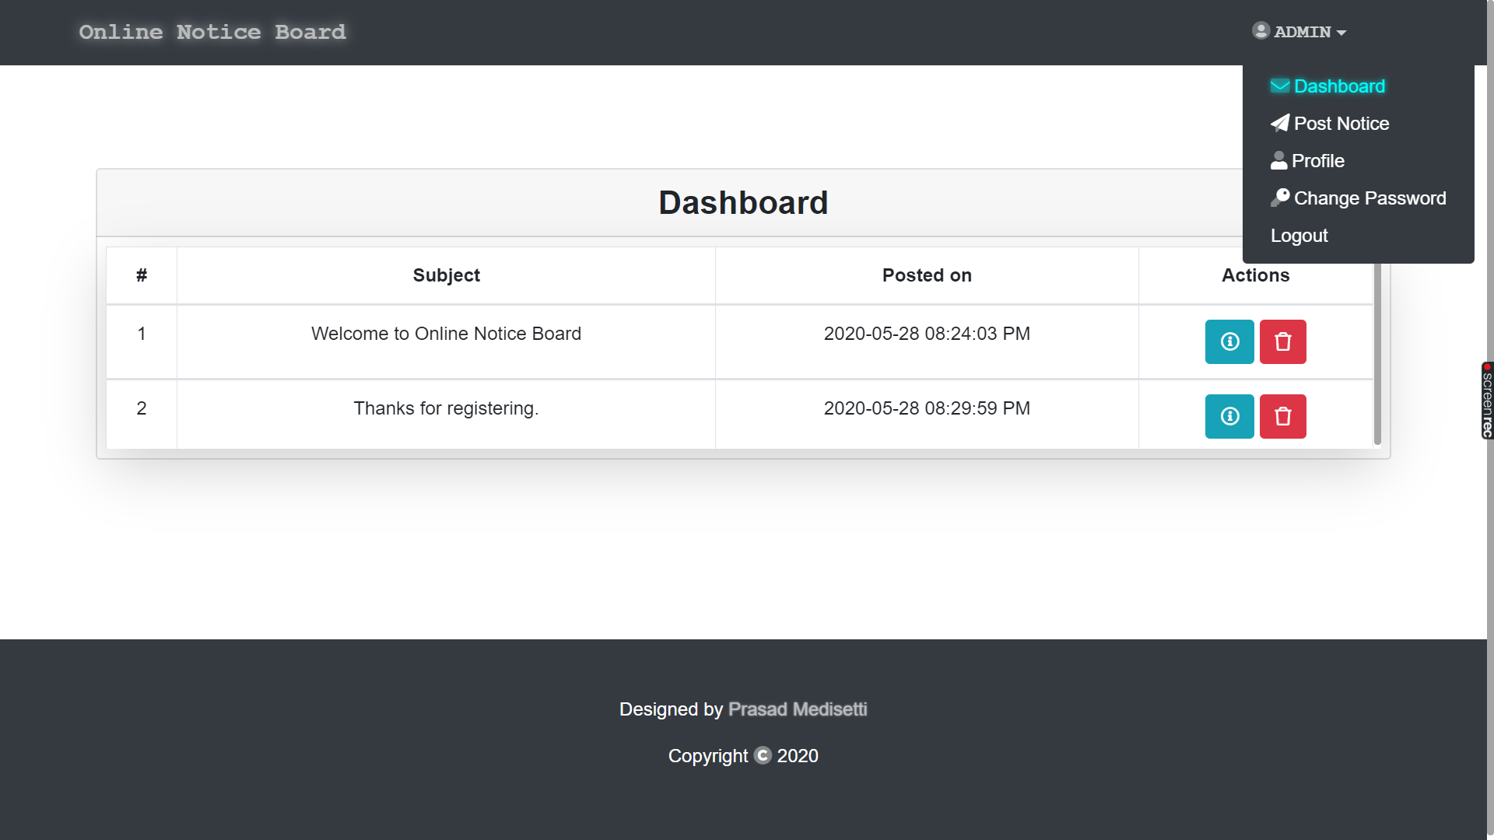

Slide 17
POST NOTICE PAGE
This is the page where the admin can make a new post.

Slide 18
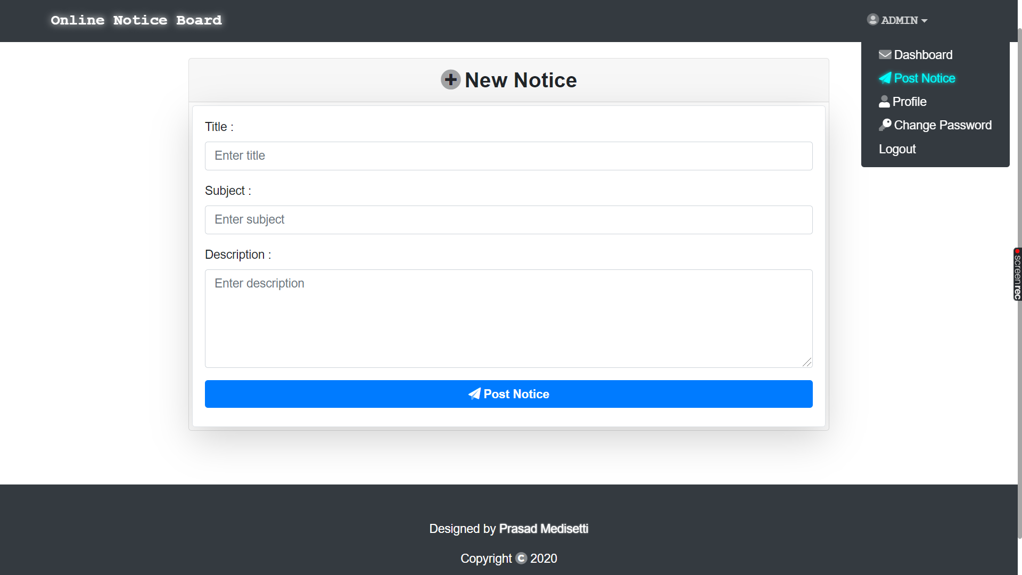

Slide 19
ADMIN PROFILE PAGE
This is the page where the admin can manage his/her profile.

Slide 20
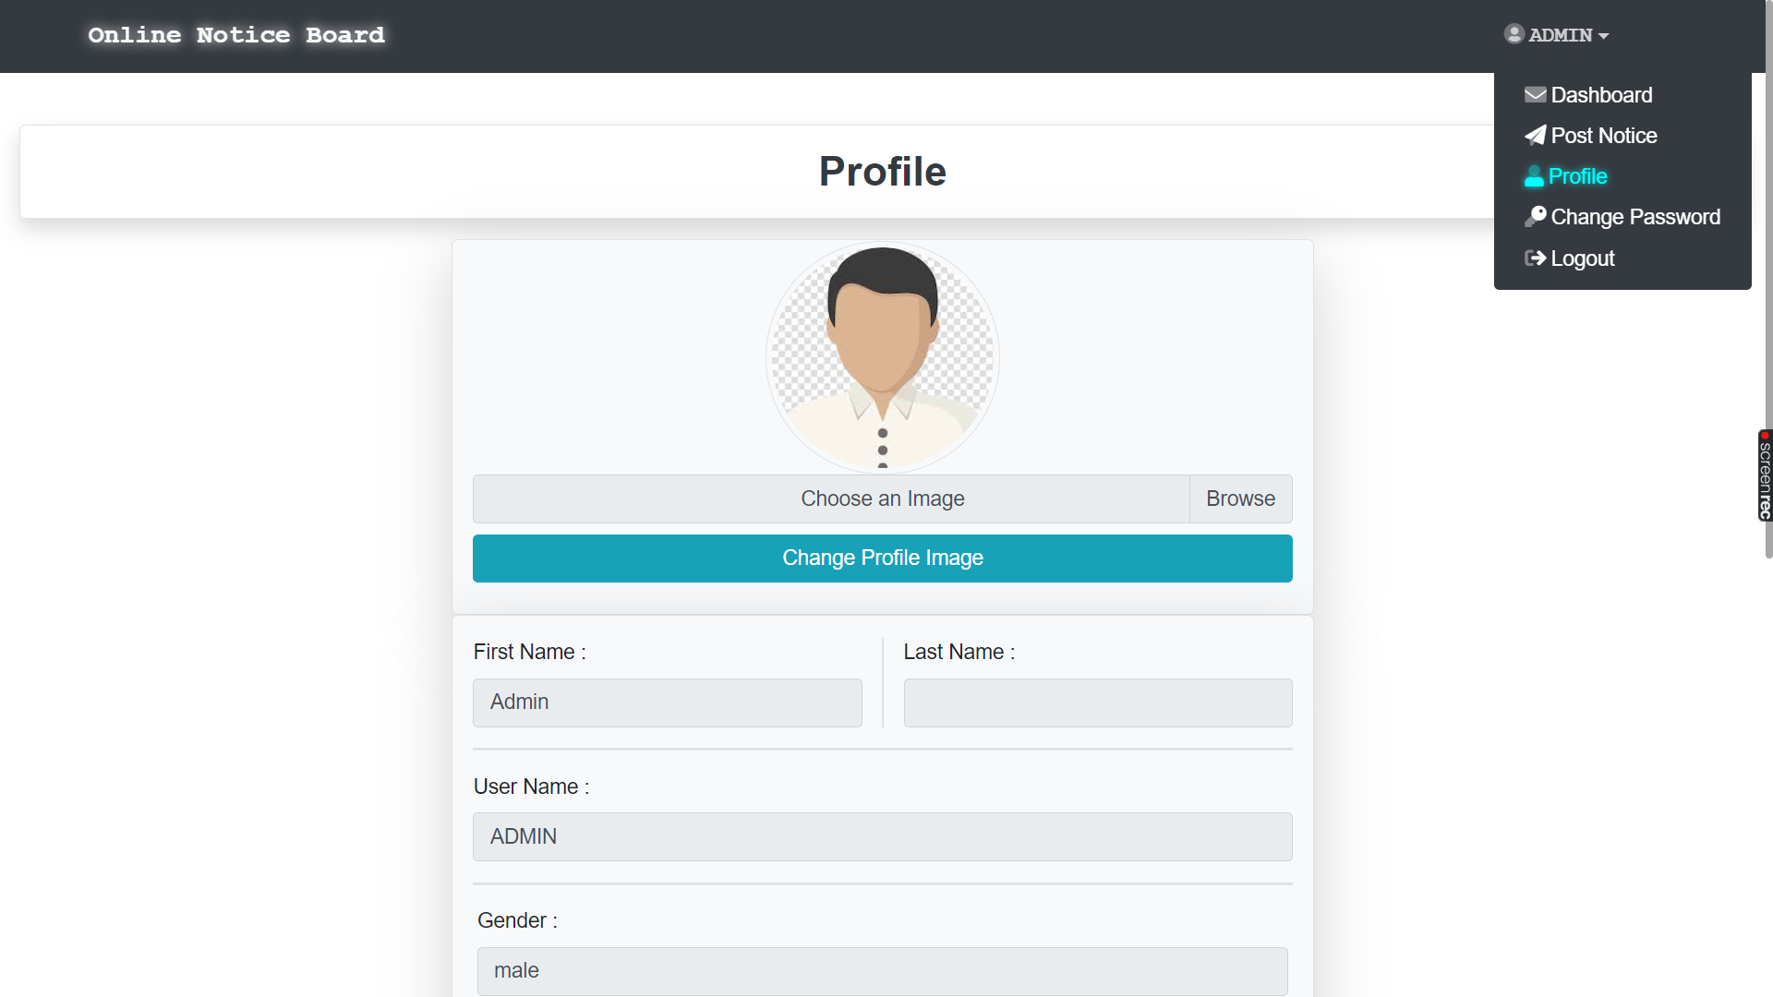

Slide 21
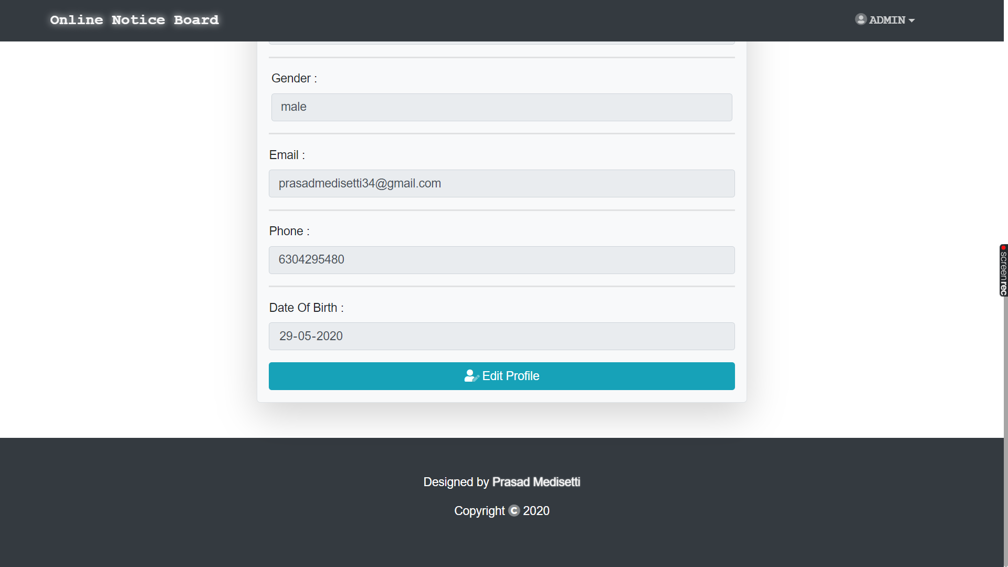

Slide 22
ADMIN CHANGE PASSWORD PAGE
This is the page where the admin can change his/her account password.

Slide 23
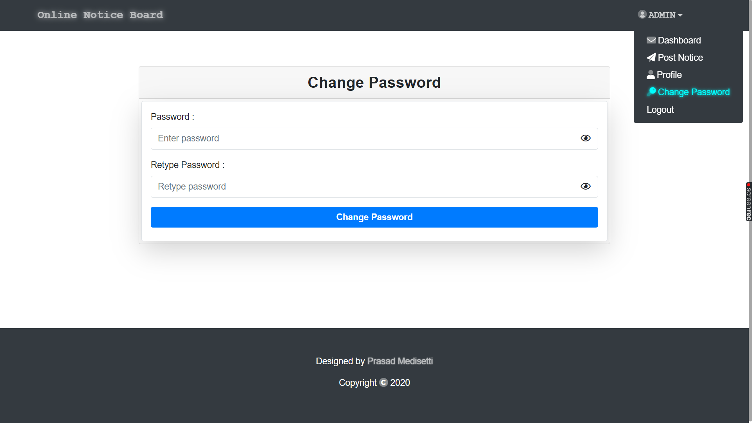

Slide 24
Table
 | A | B | C
Yellow | 10 | 20 | 7
Blue | 30 | 15 | 10
Orange | 5 | 24 | 16

Slide 25

Thank You!
Tech Coach Name

